Slide 1
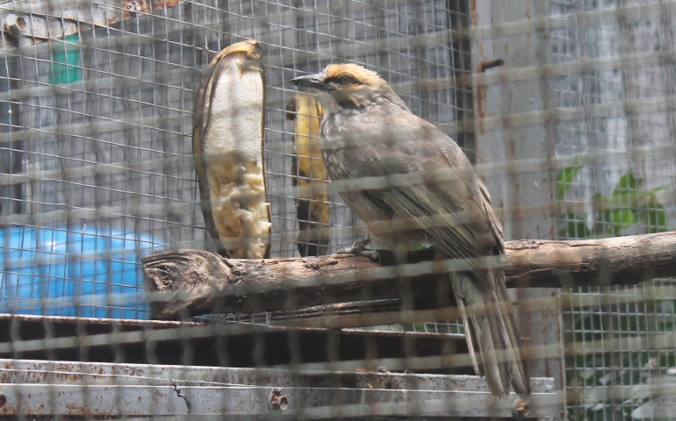
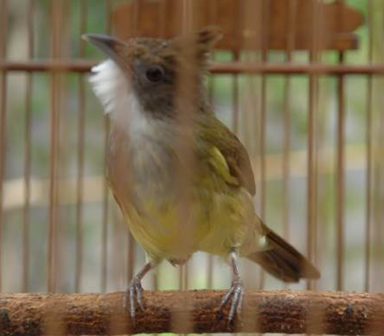
Trapping for the pet trade drives range contractions in wild bird populations
Katherine Lauck, WFCB Karp Lab

Slide 2
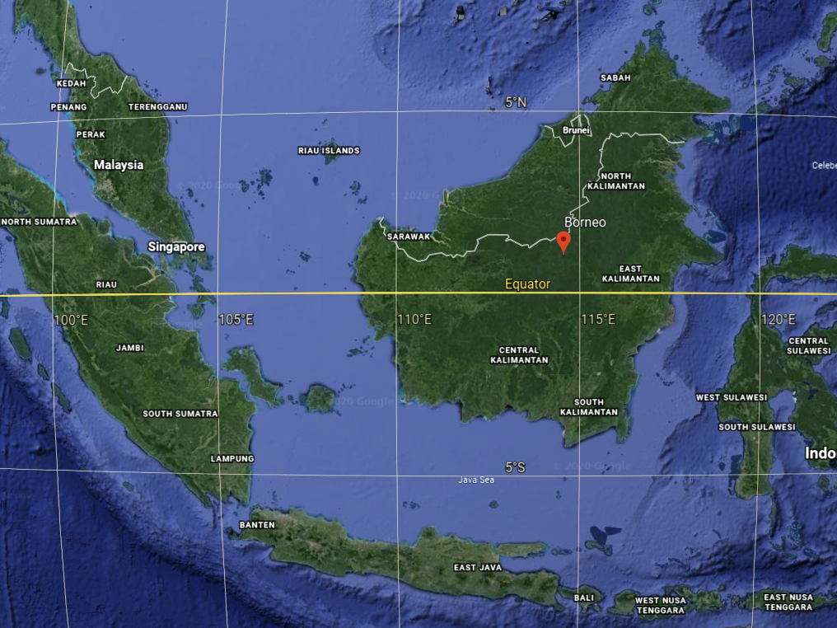
Notes:
This project was based in Indonesia, specifically in the Indonesian part of Borneo, called Kalimantan, this Southeast part of Borneo.

Slide 3
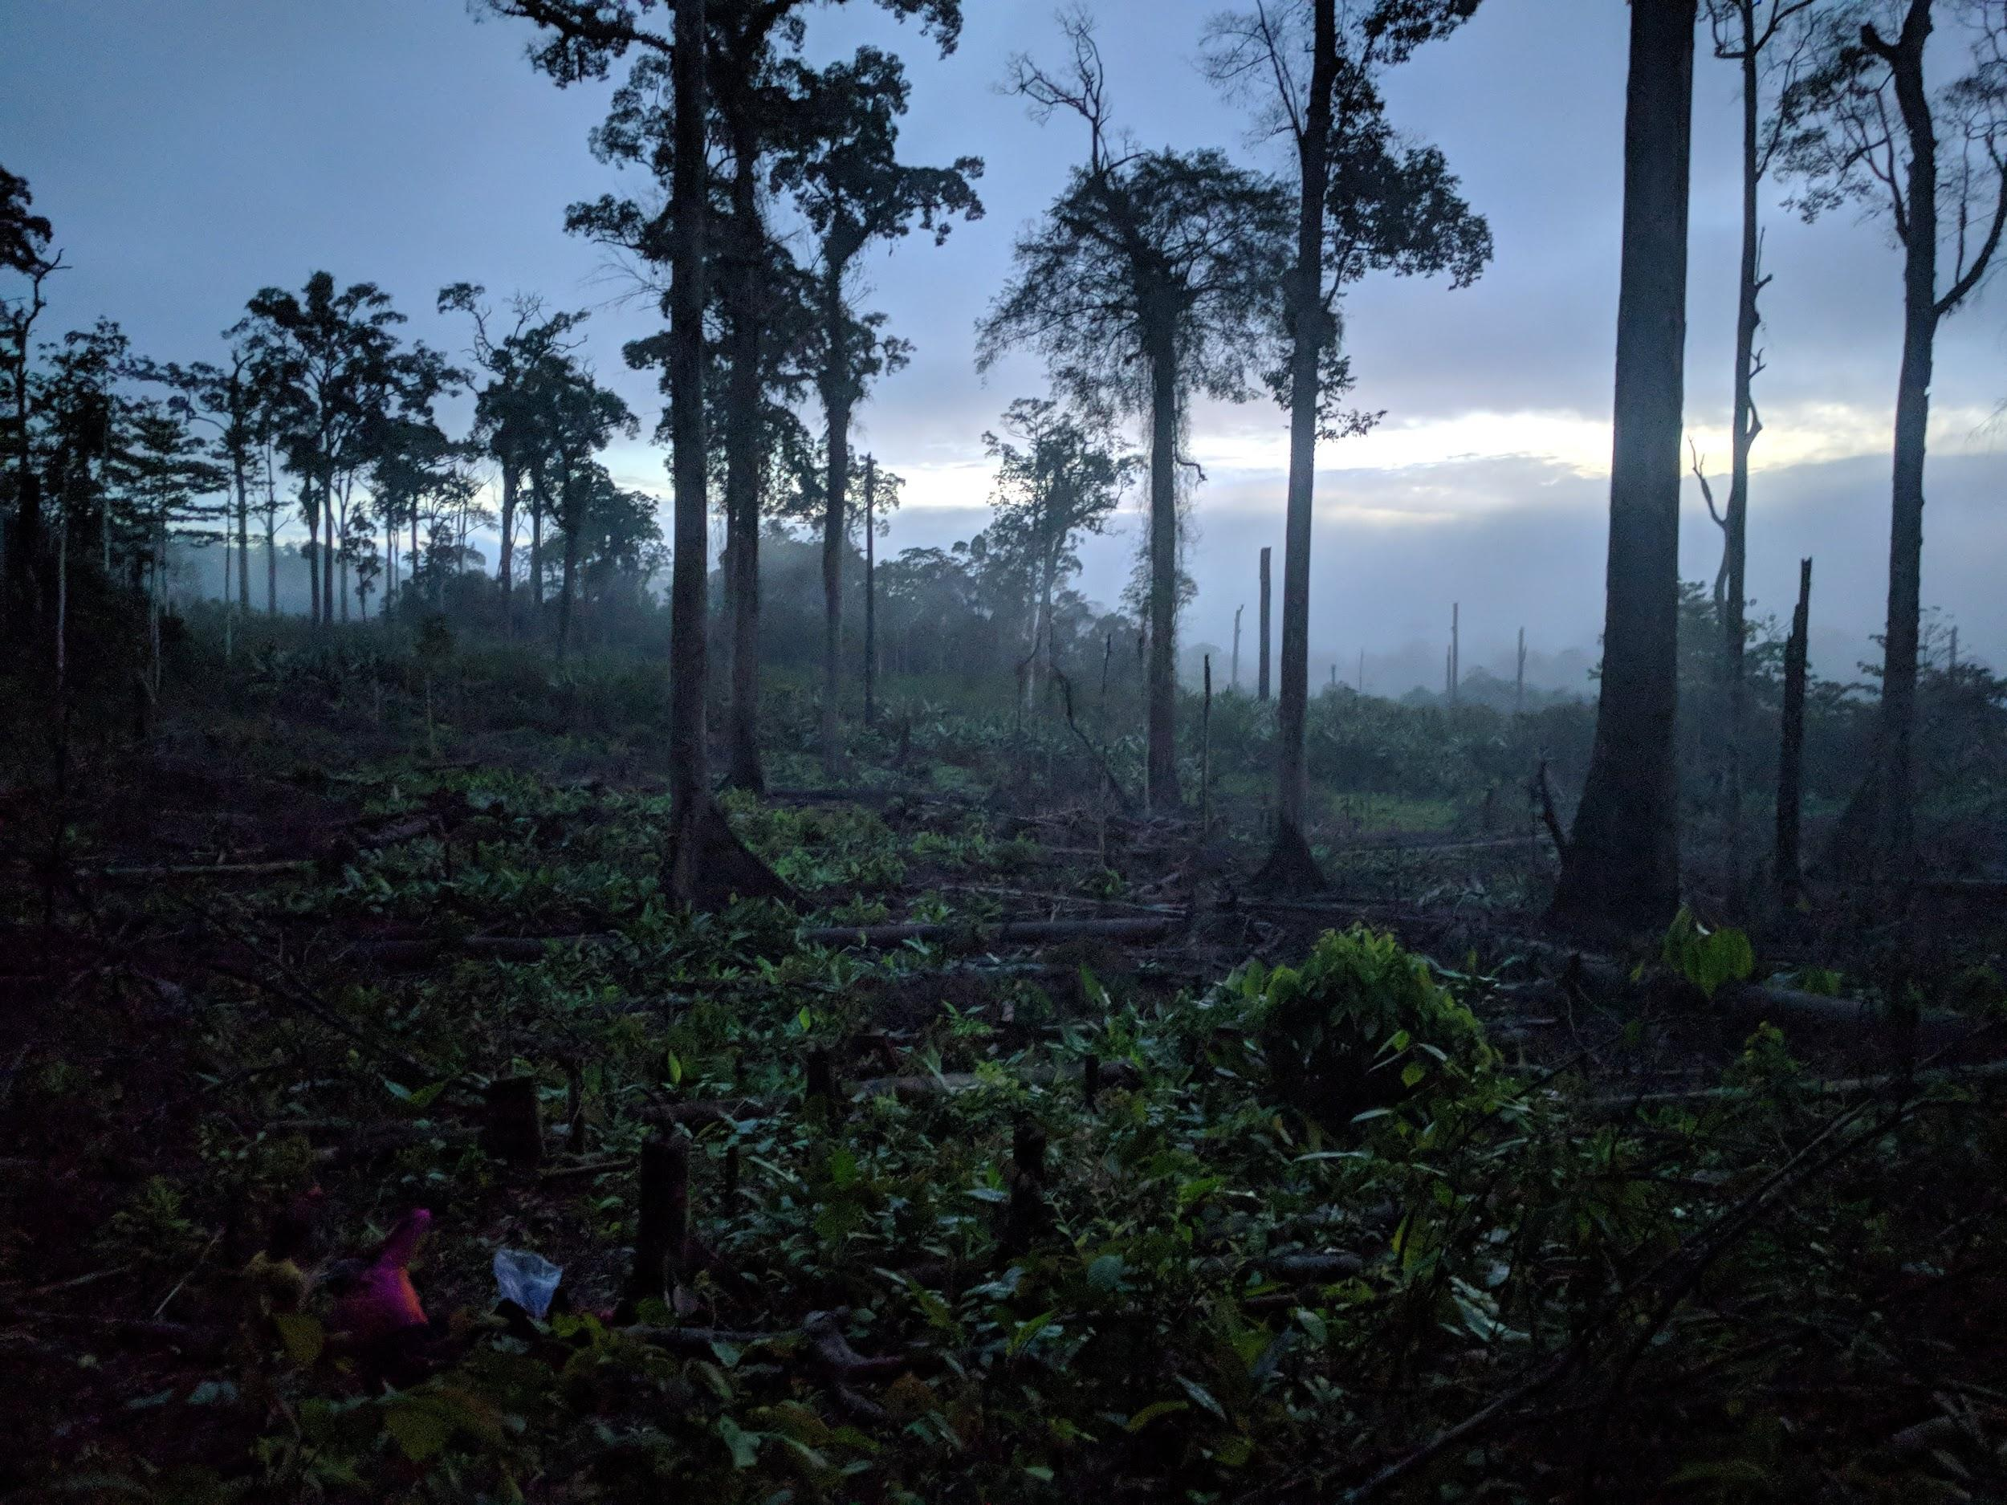
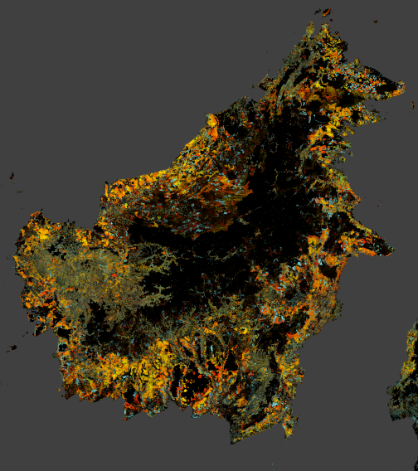
Notes:
The biggest threat to biodiversity on Borneo is deforestation. This is near one of my field sites - a patch of primary forest slashed and burned for rice agriculture. https://www.grida.no/resources/8330 this map from Global Forest Change shows enormous amount of forest loss just since 2000, and it’s currently accelerating.

Slide 4
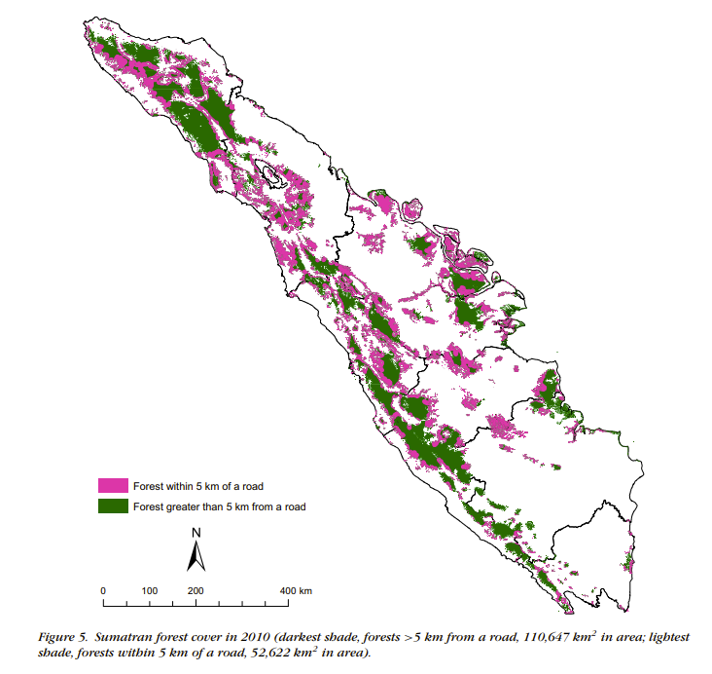
J. B. C. Harris, M. W. Tingley, F. Hua, D. L. Yong, J. M. Adeney, T. M. Lee, W. Marthy, D. M. Prawiradilaga, C. H. Sekercioglu, Suyadi, N. Winarni, D. S. Wilcove, Measuring the impact of the pet trade on Indonesian birds: Bird Declines from Pet Trade. Conservation Biology. 31, 394–405 (2017).
Notes:
Roads accompany deforestation and provide access to more interior forests that would otherwise be inaccessible. This map of tree cover in Sumatra shows that a large portion of remaining forest in Sumatra is within 5 km of a road - that’s the purple.

Slide 5
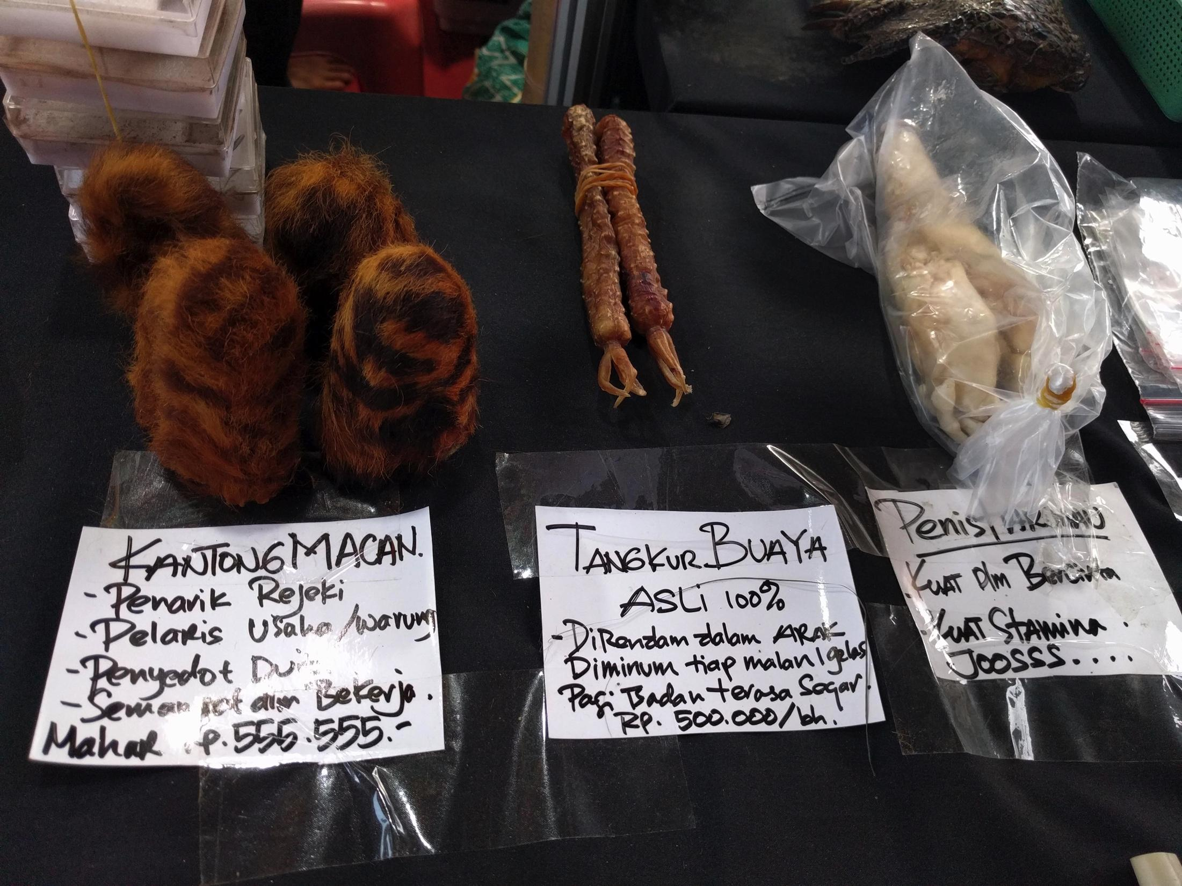
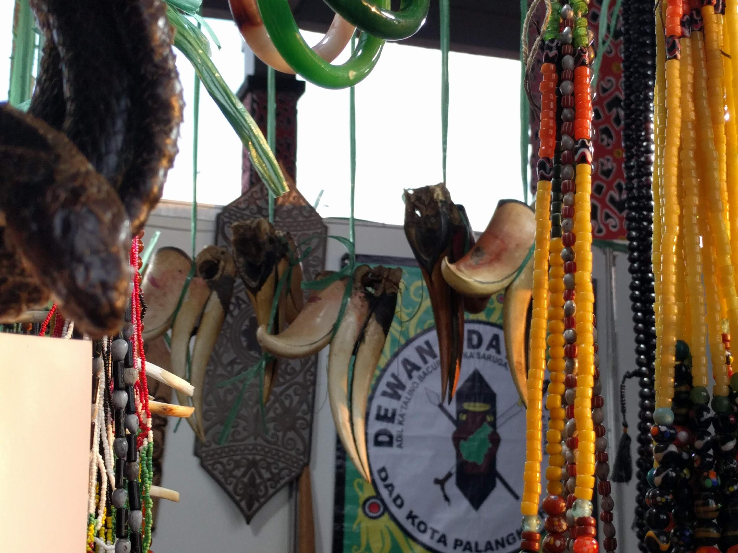
Notes:
This increased access to roads allows people to enter further and further into the forest to hunt and trap animals for a variety of purposes. On the top are animal parts - tiger testicles, crocodile penises, and hornbill heads - used as traditional medicine. On the bottom are live birds trapped in the wild for the pet trade in singing birds.

Slide 6
Straw-headed Bulbul, now listed as Critically Endangered
BirdLife International (2020) IUCN Red List for birds
1.2 million songbirds purchased annually in 6 largest Javan cities, 60% of which are trapped in the wild
Kept for cultural tradition and song competitions
Individuals of prized species can be sold for $100s
In 2018, some birds protected under updated Indonesian law, but Straw-headed Bulbul and White-rumped Shama removed from protected list a few months later
Notes:
This trade is extensive. 1.2 million songbirds are purchased annually in the 6 largest Javan cities… and this is only a fraction of the trade. SE Asian Songbird Crisis Summit identified 28 Indonesian taxa as severely threatened by the bird trade, including 6 detected in our survey.

Slide 7
Questions & hypotheses
Q1: How does trapping for the bird trade affect wild bird populations?
H1: Commercially valuable species will be found further from roads than non-valuable species
Q2: How does deforestation affect wild bird populations?
H2: All species will be more likely to occupy areas with more intact forest
Notes:
These recommendations are based primarily on market data. Lack of systematic surveys connecting trapping pressure to wild population declines. So, we asked: … To test H1, I used distance from road as a proxy for trapping pressure (because trapping pressure is really hard to measure) - as in Harris et al mentioned earlier. Question 2 function: separate deforestation effects from trapping pressure effects (as both will decrease with distance to road)

Slide 8
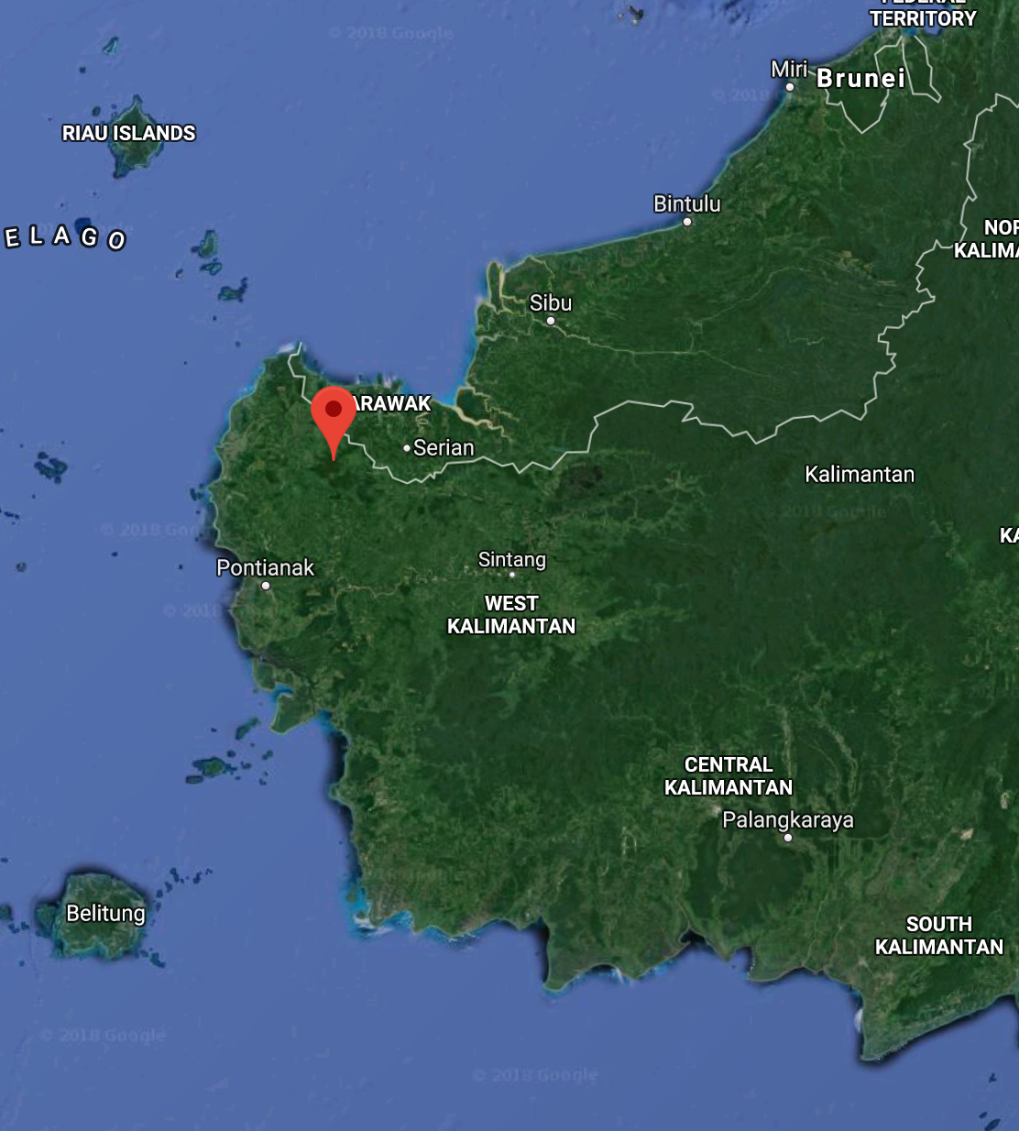
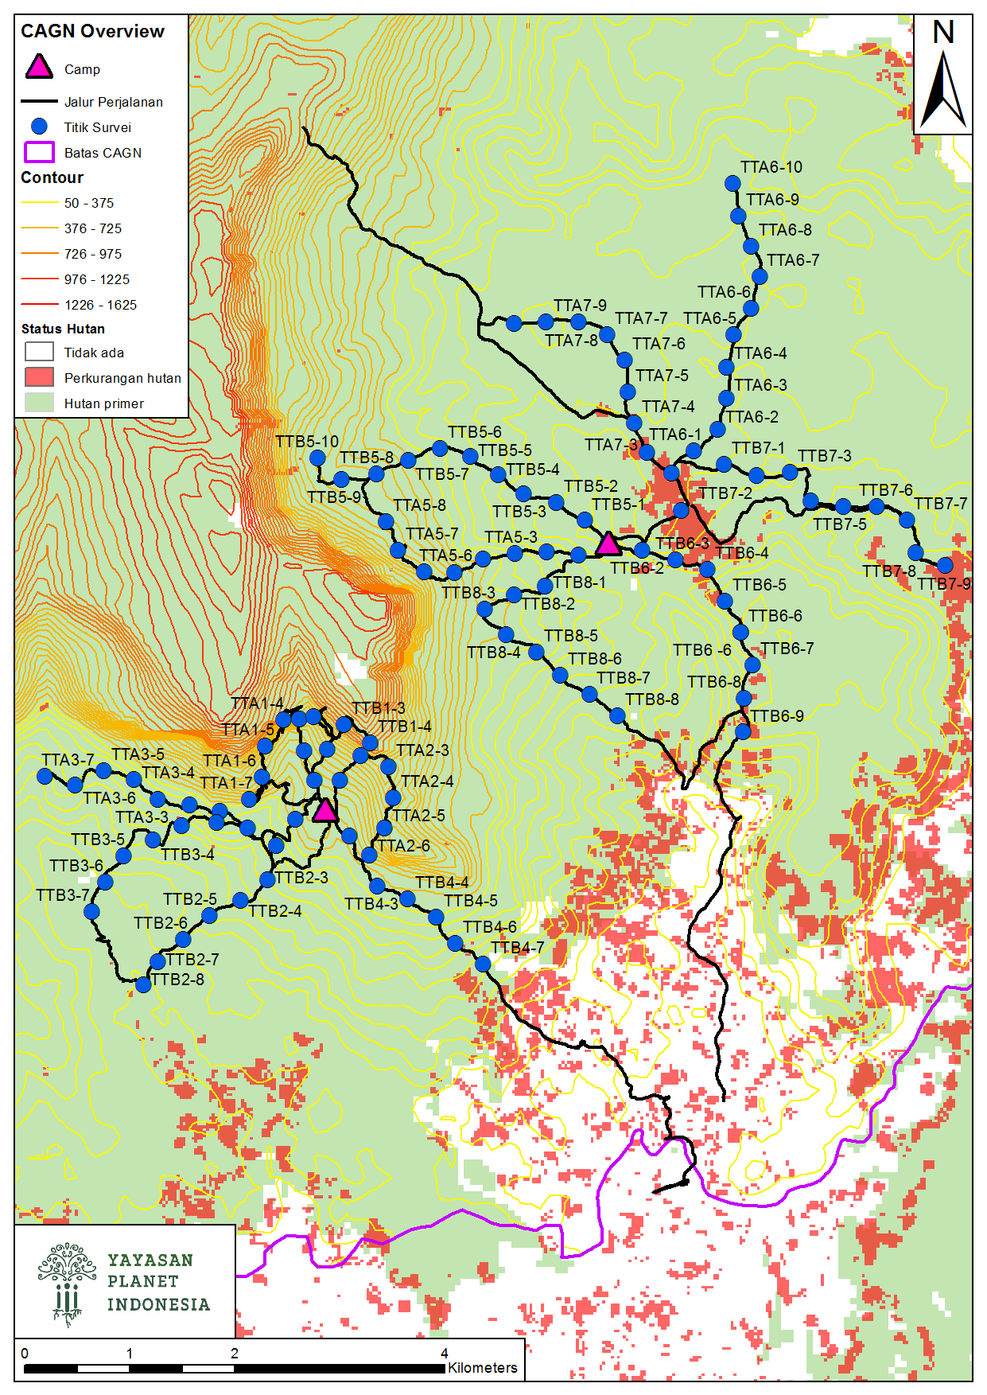
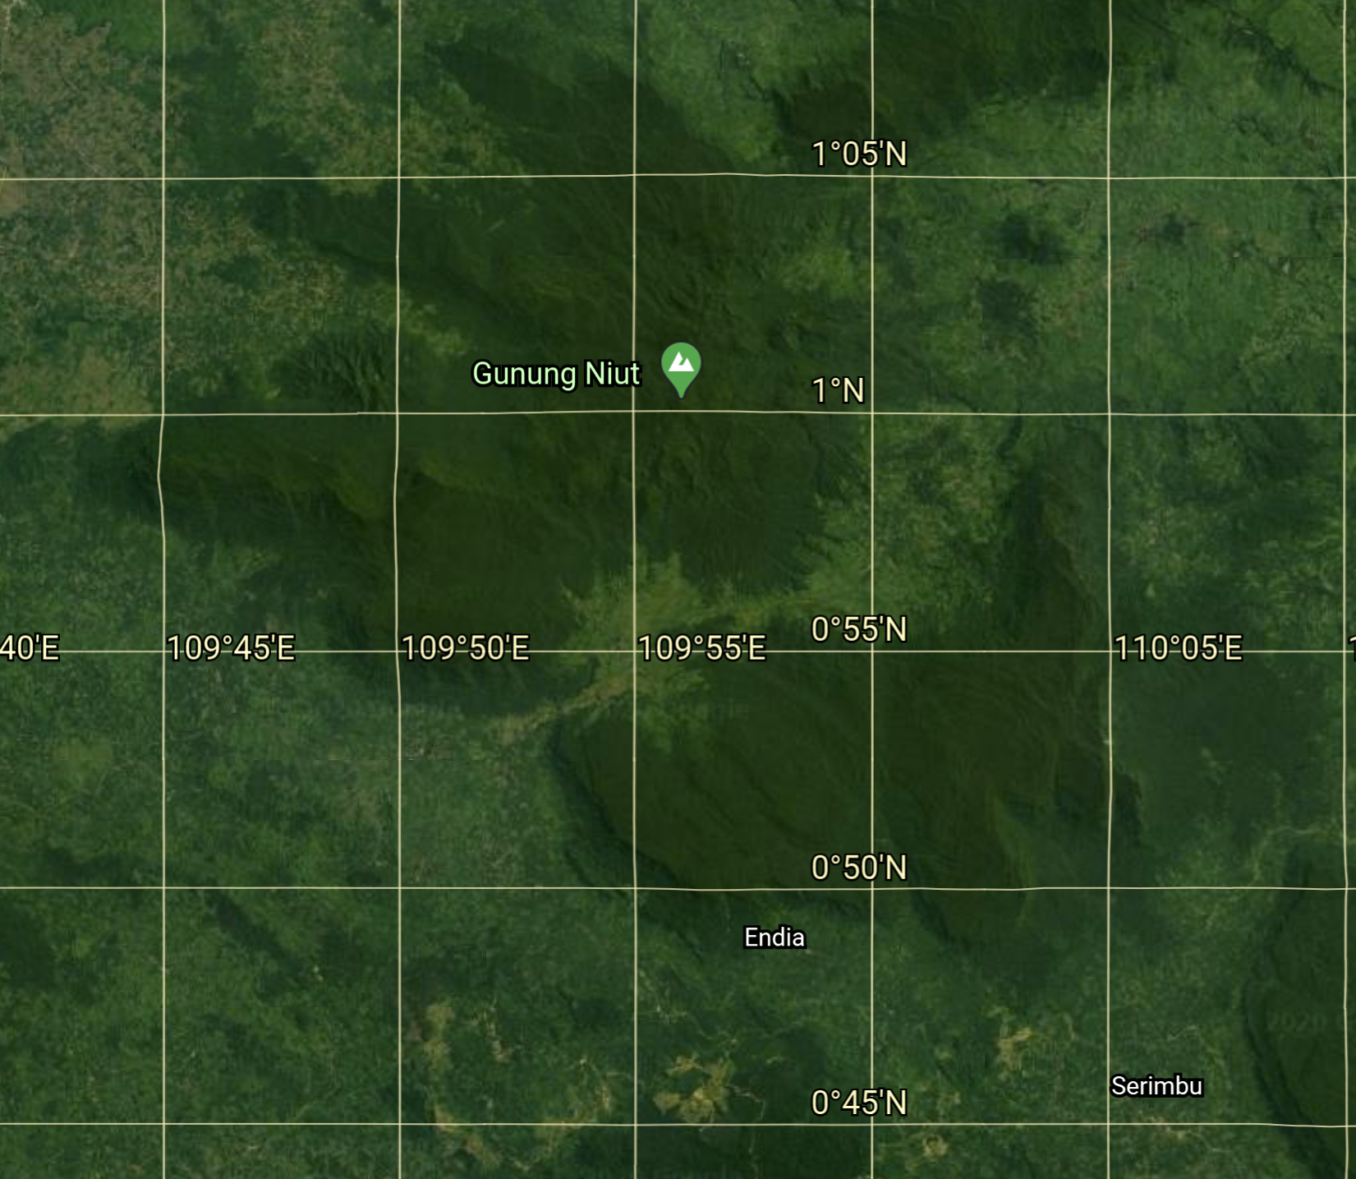
Cagar Alam Gunung Niyut
Notes:
To answer this question, we conducted point counts in a nature reserve in Kalimantan, at these 115 sites arrayed along a remoteness gradient, five times each. The purple line indicates the border of the nature reserve, and the red indicates recent forest loss.

Slide 9
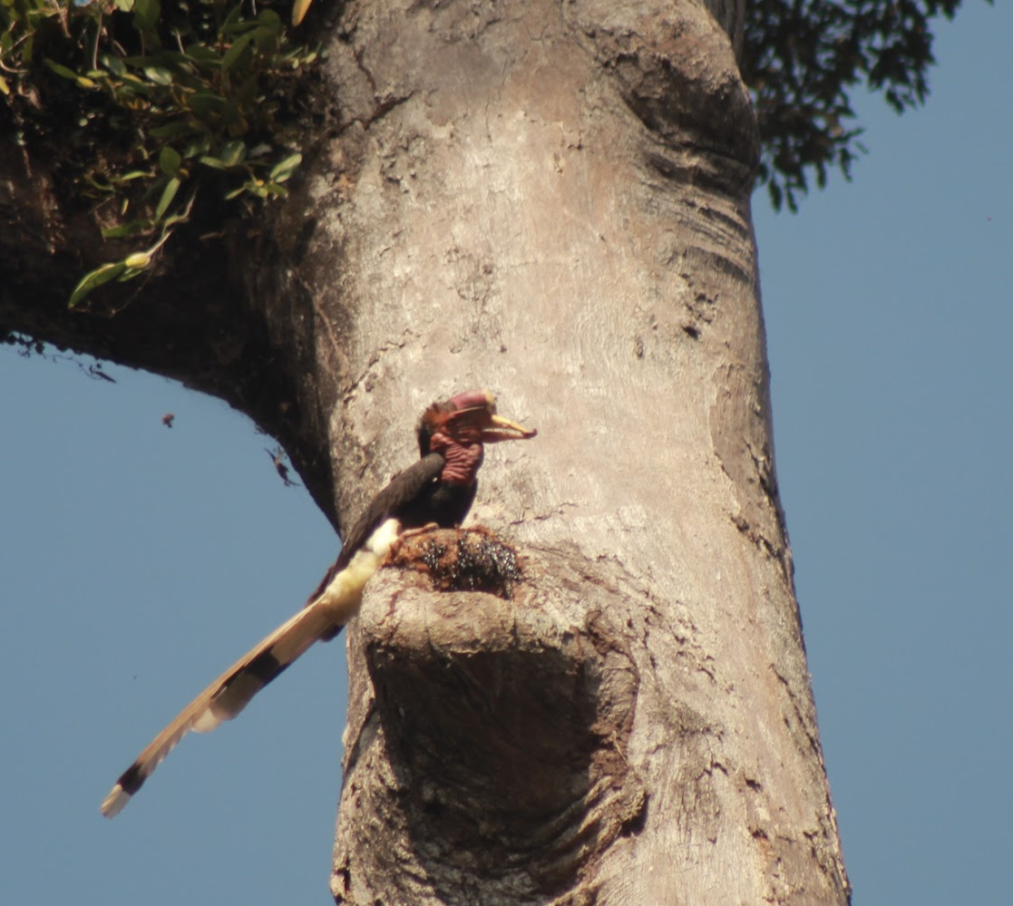
Point count results
206 species detected
No Straw-headed Bulbul
We found 6 species that were recommended for international protection by the Songbird Crisis Summit 2017
Several individuals of Helmeted Hornbill and on our last visit, a nest!!!
Notes:
[read slide]

Slide 10
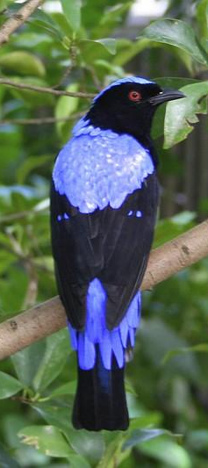
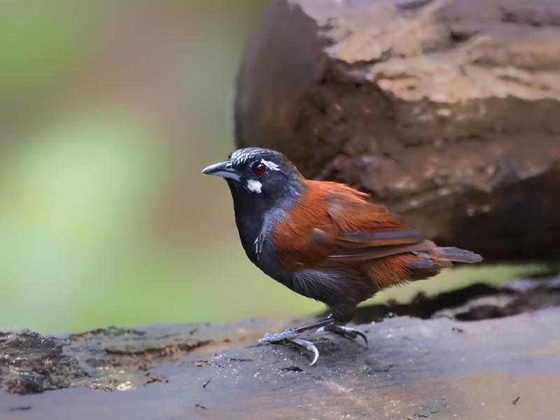
Analysis: Bayesian community occupancy model
Estimated effect of distance to road and intact forest on occupancy of commercially valuable and non-valuable species
Classified species as commercially valuable based on market surveys
Corrected for imperfect detection and species habitat preferences
Notes:
Community occupancy model allows species’ responses to each habitat variable to share information

Slide 11
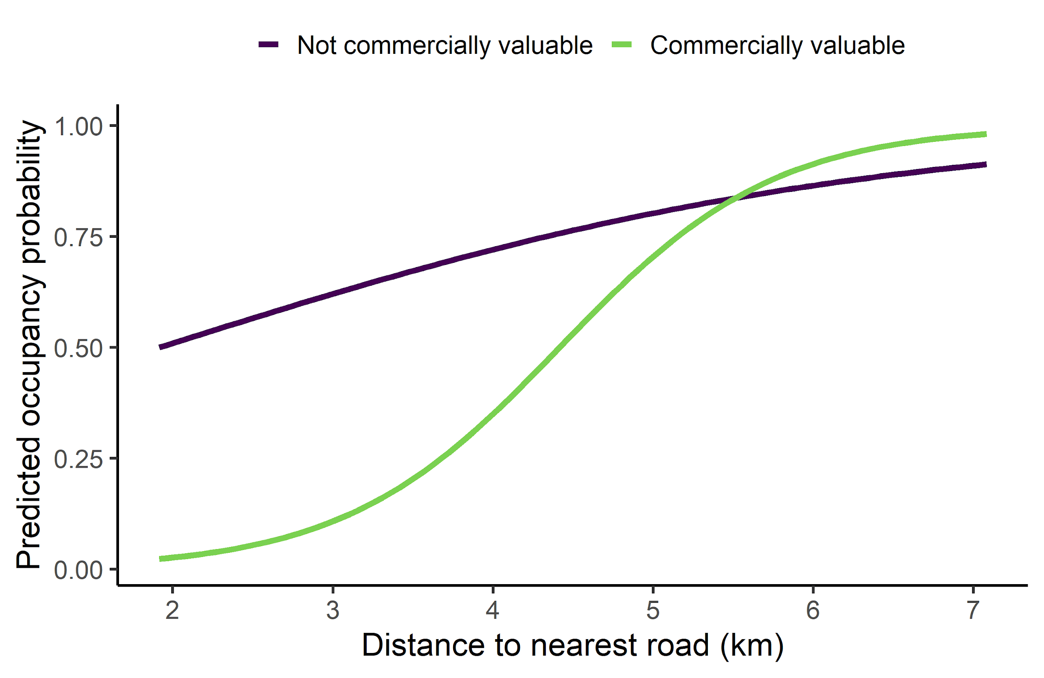
Q1: Commercially valuable species are found further from roads than non-valuable species
Notes:
I found that:
x axis is distance to nearest road, y axis is predicted occupancy probability, and the purple (or dark) line indicates the average species that is not commercially valuable, whereas the green (or light) line indicates the average commercially valuable species.
while both groups increase in occupancy with distance to road, commercially valuable species are very unlikely to occupy areas near roads.

Slide 12
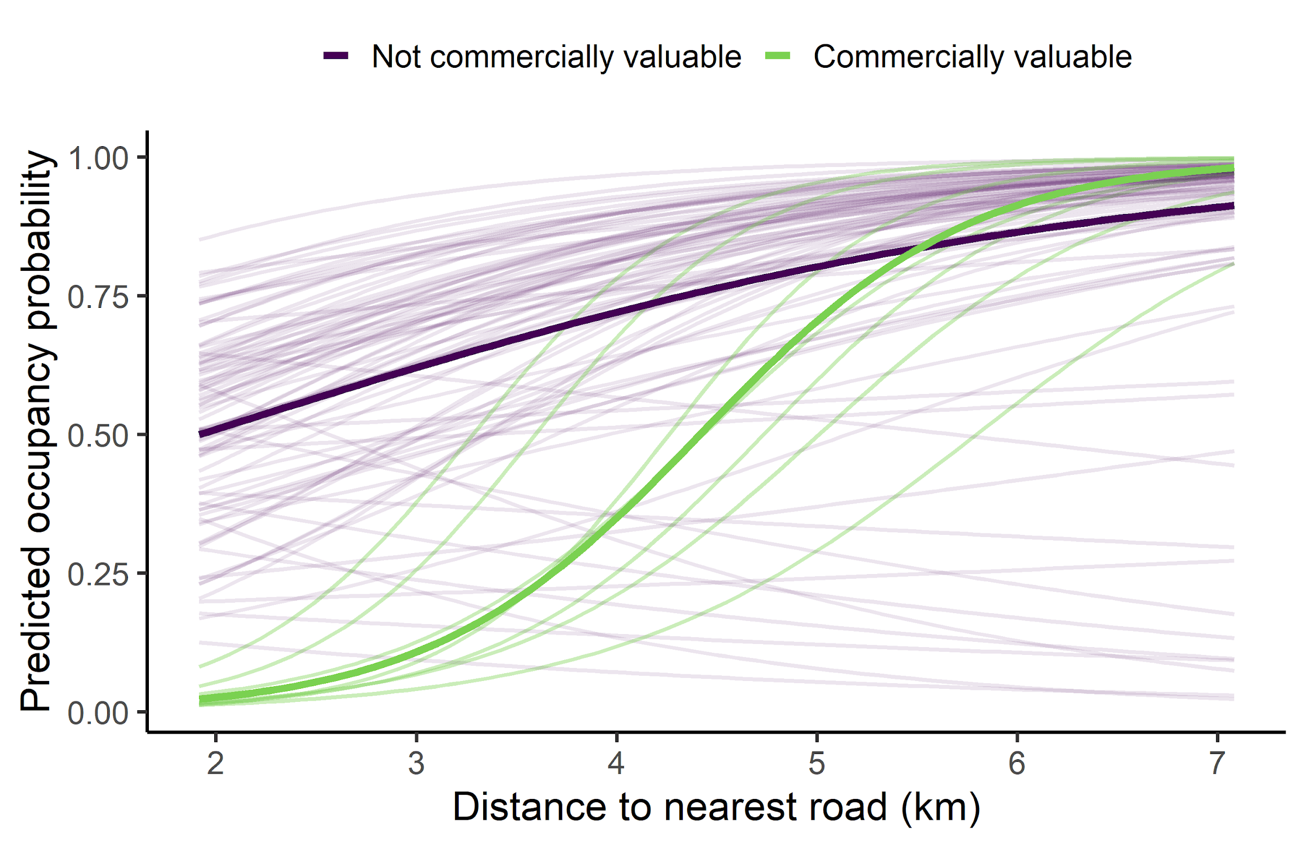
Q1: Commercially valuable species are found further from roads than non-valuable species
Notes:
Adding the lines for each species, interestingly, some non-valuable species do decrease in occupancy with distance to road while all valuable species increase in occupancy.
while both groups increase in occupancy with distance, commercially valuable species are very unlikely to occupy areas near roads

Slide 13
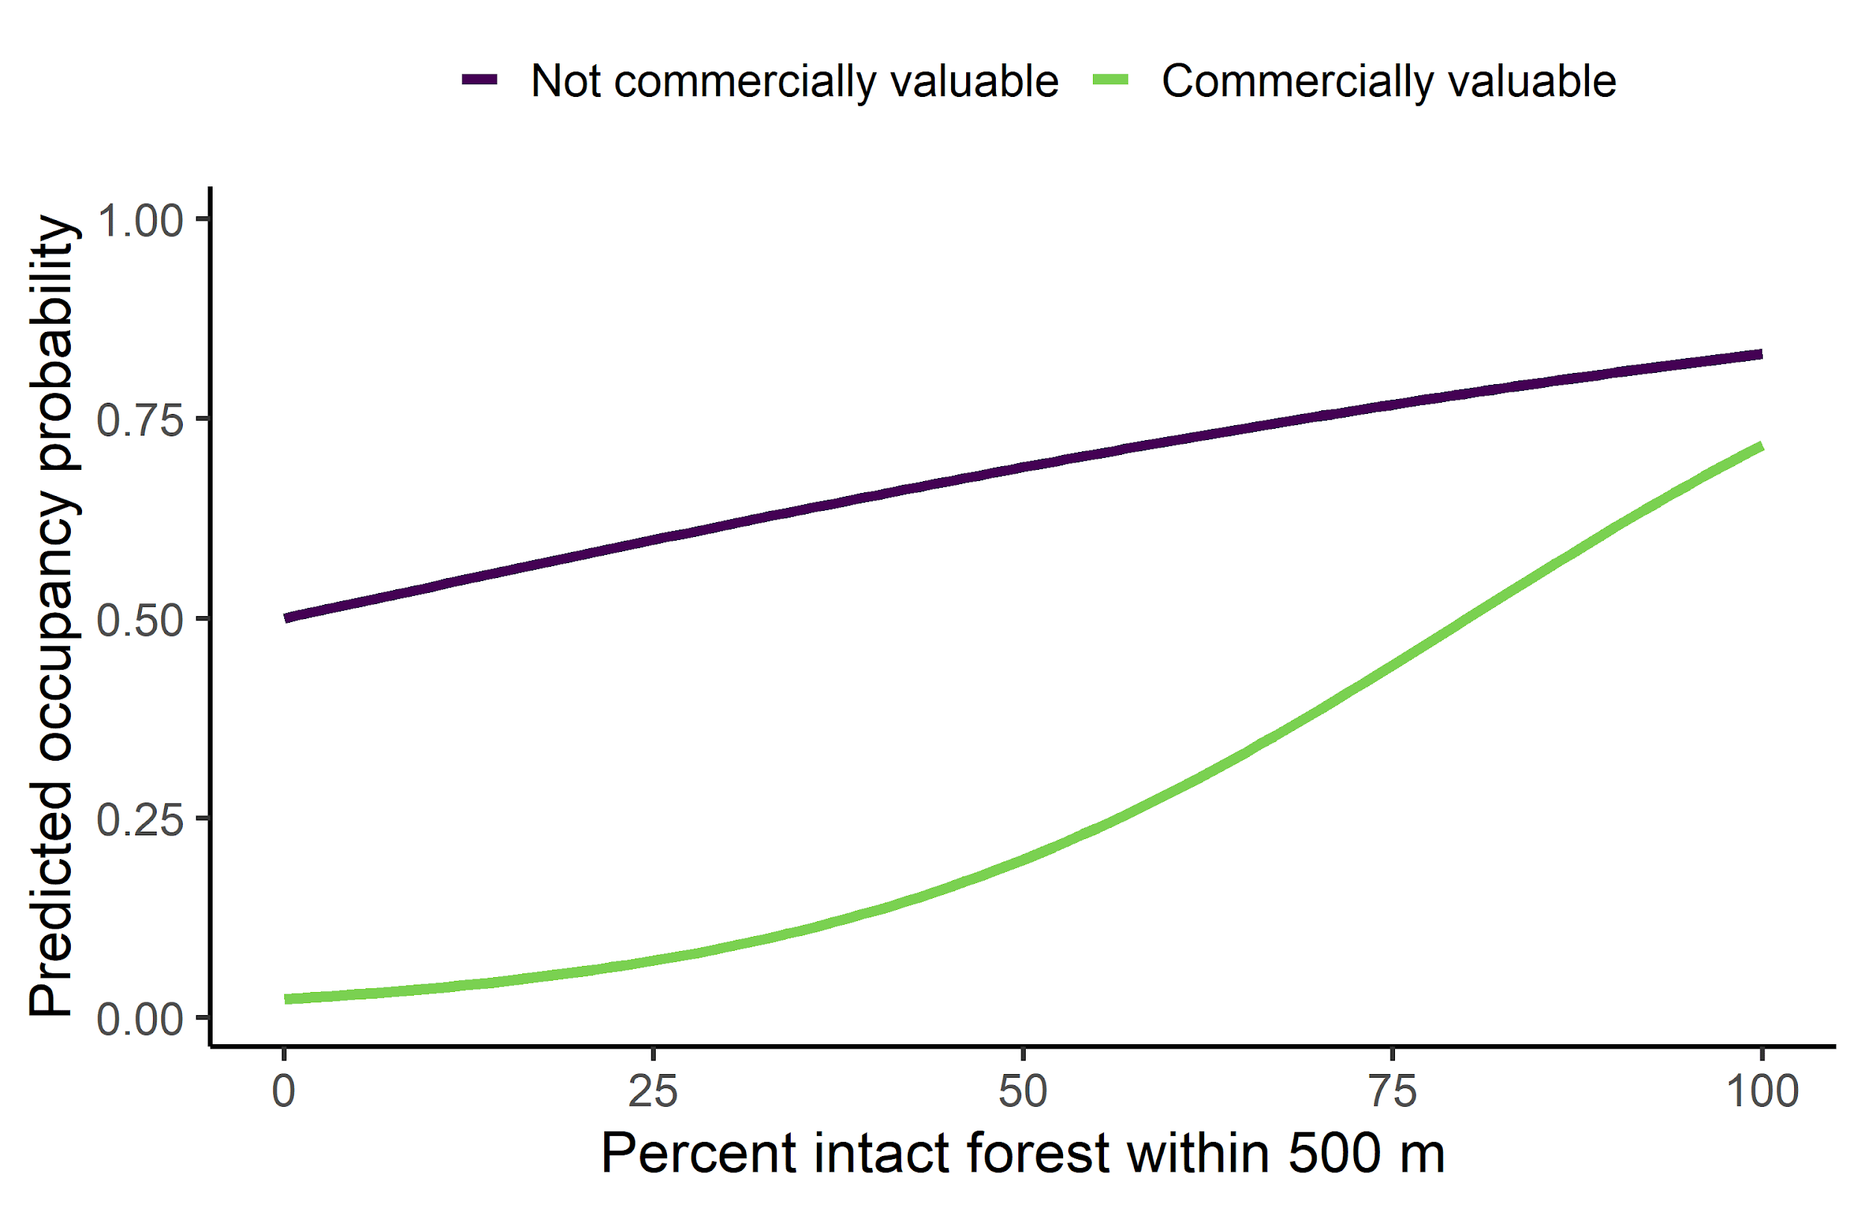
Q2: Most species are more likely to occupy areas with more intact forest
Notes:
I also found that:
note that the x axis is now percent intact forest
again, the predicted occupancy of the average species for both groups increases with increasing percentage of intact forest.

Slide 14
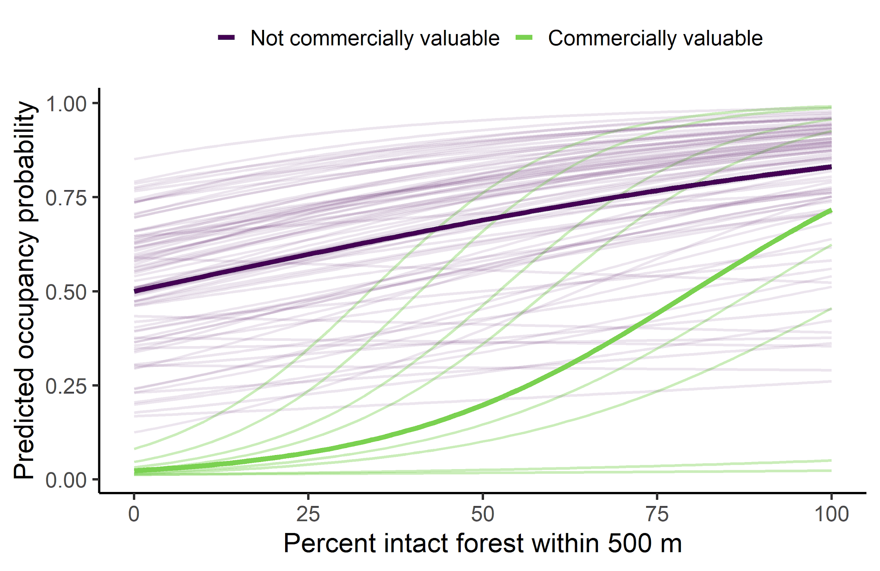
Q2: Most species are more likely to occupy areas with more intact forest
Notes:
But adding in the species lines, the distributions are now more overlapping and there is more variation among commercially valuable species.

Slide 15
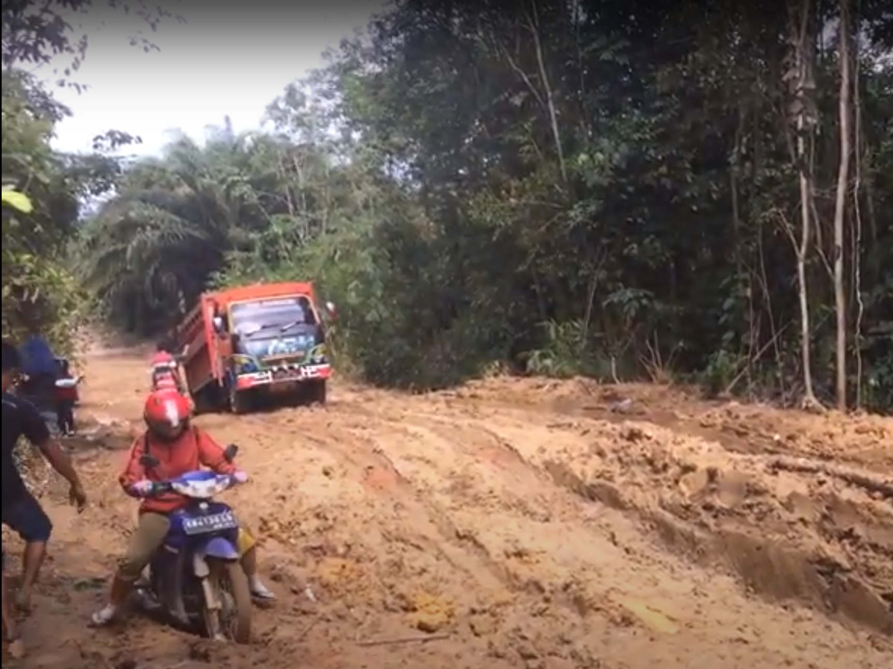
Conclusions
Range contractions of commercially valuable species evident despite remoteness and legal protection of the nature reserve where I conducted this study
Range contractions of commercially valuable species are probably driven by overexploitation, not avoidance or habitat change
Expansion of roads in Kalimantan will likely cause loss of viable bird habitat for commercially valuable species even if deforestation stops.

Slide 16

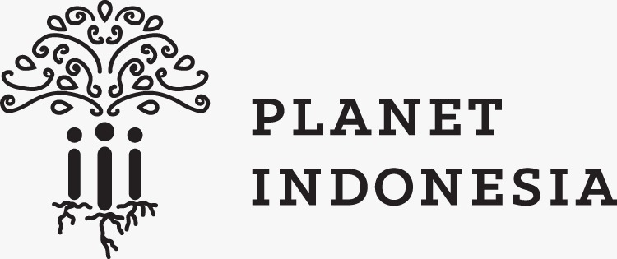


A big thank-you to my partners

Slide 17
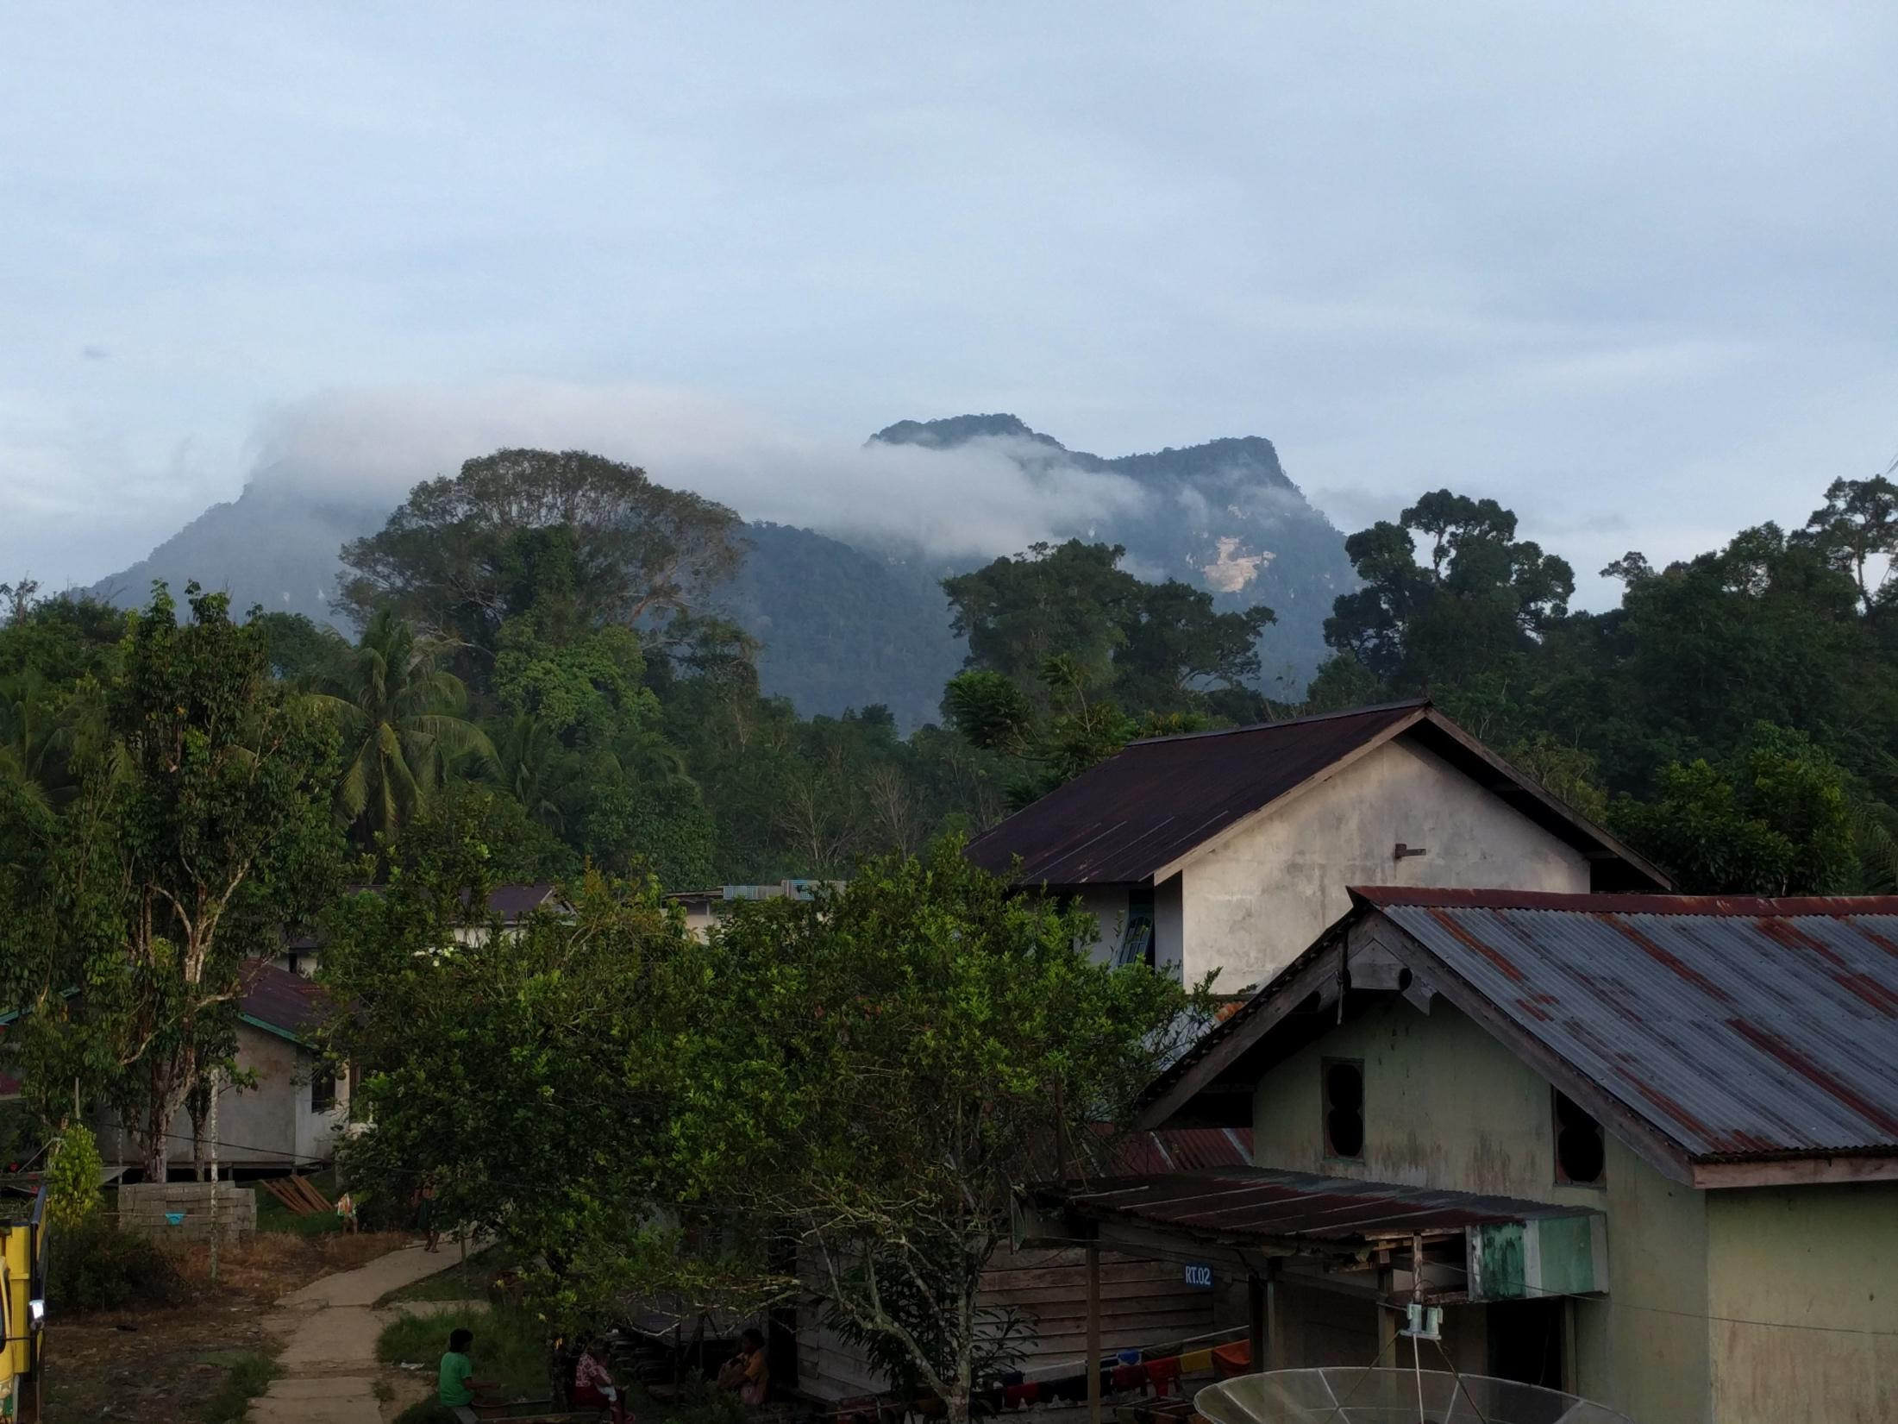
And thank you, too!
Question time!

